Slide 1
Counters and Time Delays

Slide 2
Introduction
In real life applications, it is important to keep a track with time.
For example:
In traffic light control application, it is necessary to give time delay between two transitions.
These time delays are in few seconds
Can be generated with help of executing a group of instructions number of times

Slide 3
Counters
A loop counter is set up by loading a register with a certain value
Then using the DCR (to decrement) and INR (to increment) the contents of the register are updated.
A loop is set up with a conditional jump instruction that loops back or not depending on whether the count has reached the termination count.

Slide 4
Timer Delay using Counters
Counting can create time delays
As execution time of instructions are known, the initial value of counter required to get specific time delay can be pre-determinded.

Slide 5
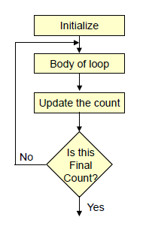
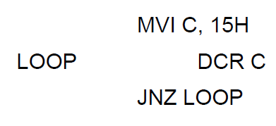
Counters
The operation of a loop counter can be described using the following flowchart.

Slide 6
Delays
Each instruction passes through different combinations of Fetch, Memory Read, and Memory Write cycles.
If number of T states of an instruction is known, we can calculate the time or delay using the following formula:
Delay = No. of T States / Frequency
For example a MVI instruction uses 7 T-States. Therefore, if the Microprocessor is running at 2 MHz, the instruction would require 3.5 μSeconds to complete.

Slide 7
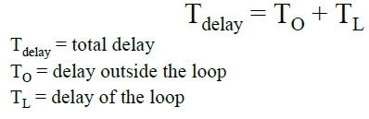
Delay loops
We can use a loop to produce a certain amount of time delay in a program.
To calculate the delay, the following formula can be used.

Slide 8
Delay loop using 8 bit Count
No of T states
MVI C, count 7
BACK: DCR C 4
JNZ BACK 10/7
For the Jump instruction:
Number of T states is 7 when condition is not met.
Number of T states is 10 when the condition is met

Slide 9
Delay loops
The first instruction initializes the loop counter and is executed only once requiring only 7 T-States.
The following two instructions form a loop that requires 14 T-States to execute and is repeated 255 times until C becomes 0.
In the last iteration of the loop, the JNZ instruction will fail and require only 7 T-States rather than the 10.

Slide 10
Total T states required to execute the program
= 7 + (count-1) (4+10) + (4+7)
MVI C Loops Last loop
Suppose count=5
Number of T states=7+ (5-1)14 + 11 =74
Assume operating frequency is 2 MHz
Time required for 1 T state=1 /2= 0.5 micro secs
Total time to execute the given program= 74 *0.5=37 micro secs

Slide 11
Maximum delay possible with 8 bit count
Maximum count can be loaded= FF H (=255)
Maximum delay possible with 8 bit count
=[7 + (255 – 1) 14 +11] *0.5 micro secs
=1787 micro secs
Note:
Delay with 8 bit count is suitable for small delays and not for large delays

Slide 12
Using a Register Pair as a Loop Counter
Using a single register, one can repeat a loop for a maximum count of 255 times ( As maximum count is FFH).

Slide 13
Using a Register Pair as a Loop Counter
It is possible to increase this count by using a register pair for the loop counter instead of the single register.
A minor problem arises in how to test for the final count since DCX and INX do not modify the flags.
However, if the loop is looking for when the count becomes zero, we can OR the two registers in the pair and then checking the zero flag.

Slide 14
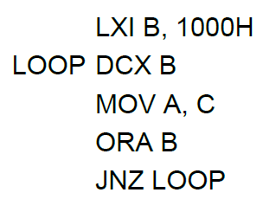
Using a Register Pair as a Loop Counter
The following is an example of a loop set up with a register pair as the loop counter.

Slide 15
Delay loop using 16 bit counter
No of T states
LXI B, count 10
BACK: DCX B 6
MOV A, C 4
ORA B 4
JNZ BACK 7/10

Slide 16
The instruction LXI B, count is executed only once, so require 10 T states
The number of T states required for one loop = 6 + 4 + 4 + 10 = 24 T states
The number of T states required for the last loop = 6 + 4 + 4 + 7= 21 T states

Slide 17
The number of T states required for the execution of the given program
= 10 + (count – 1)*24 + 21
LXI B Loops Last loop
Suppose, count = 03FFH (=1023)
Number of T states = 10 + 1022 *24 +21
= 24559

Slide 18
Assume operating frequency is 2 MHz
Time required for 1 T state=1 /2= 0.5 micro secs
Total time to execute the given program
=24599 * 0.5 micro secs
=12279.5 micro secs

Slide 19
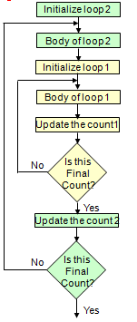
Nested Loops
Nested loops can be easily setup in Assembly language by using two registers for the two loop counters and updating the right register in the right loop.
In the figure, the body of loop2 can be before or after loop1.

Slide 20
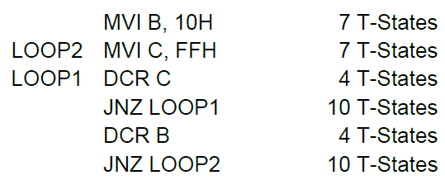
Nested Loops for Delay
Instead (or in conjunction with) Register Pairs, a nested loop structure can be used to increase the total delay produced.

Slide 21
Delay of Nested Loops
The calculation remains the same except that it the formula must be applied recursively to each loop.
Start with the inner loop, then plug that delay in the calculation of the outer loop.

Slide 22
Delay of inner loop
T states required for execution of inner loop (Ti)
= 7 + (255 – 1)*14 +11
MVI C
T states required for execution of the given program= (multiplier count – 1) * (Ti + 14) + 11
MVI B

Slide 23
Increasing the delay
The delay can be further increased by using register pairs for each of the loop counters in the nested loops setup.
It can also be increased by adding dummy instructions (like NOP) in the body of the loop.
A NOP does nothing, but takes 4T states of processor time to execute.

Slide 24
Example 1
Write a program to generate a delay of 0.4 sec if the crystal frequency is 5MHz
Operating frequency is half of crystal frequency =5/2=2.5MHz
Time for one T-state = 1/(2.5)=0.4 micro sec
Number of T states required
=Required Time/Time for 1 T state
=0.4 sec / 0.4 micro sec
=1*10⁶

Slide 25
Delay Program
LXI B, count ;16 bit count
BACK: DCX B ;decrement count
MOV A,C
ORA B
JNZ BACK ;if result is not zero repeat

Slide 26
Number of T states
LXI B, count 10
BACK: DCX B 6
MOV A,C 4
ORA B 4
JNZ BACK 10
Number of T states required for one loop=6+4+4+10=24 T states
Number of T states required for last loop=21 T states
Total T states required for execution of given program
=10 + (Count-1) * 24 +21
LXI B Loops Last loop

Slide 27
We can compute the 16 bit count as follows.

Slide 28
Example 2
Identify the error and correct the given delay routine. Give T state of each instruction and find the maximum delay generated. Assume 1 T state = 320 nsec
DELAY: LXI H, N
L1: DCX H
JNZ L1

Slide 29
Modifications:
Number of T states
Delay: LXI H, N 10
L1: DCX H 6
MOV A, L 4
ORA H 4
JNZ L1 7/10

